Slide 1
L I B R A R Y S U P P O R T E D I N Q U I R Y
A
PROJECT

Slide 2
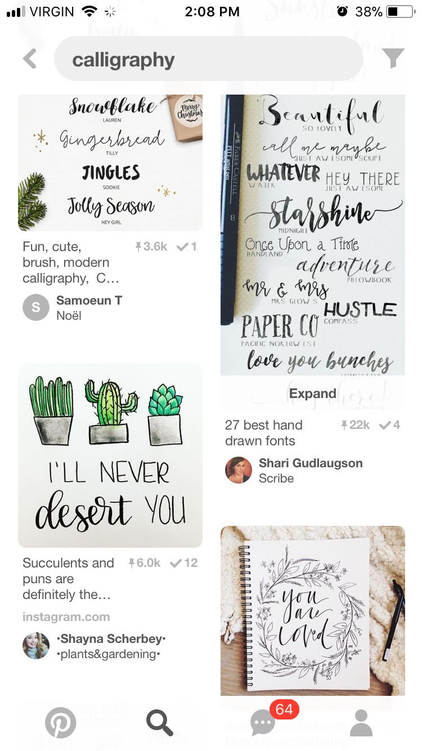
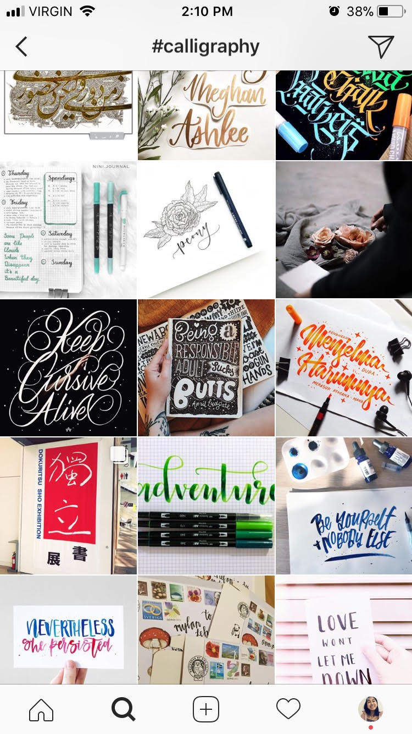
B U I L D I N G K N O W L E D G E & E X P L O R I N G I D E A S
SOURCE: The art & craft of hand lettering : techniques, projects, inspiration by Annie Cicale.
general info | calligraphy is the art of beautiful writing/lettering there are specific pens/materials you can use to create it, for example brush pens watercolours felt tip markers dip pens/nibs often combined with minimalistic drawings (usually plants) there are several different uses recreational purposes (eg. journaling) wedding/event purposes (eg. invitations) home decor (eg. framed quotes)
https://www.pinterest.ca/search/pins/?q=calligraphy&rs=typed&term_meta[]=calligraphy%7Ctyped
https://www.instagram.com/explore/tags/calligraphy/?hl=en

Slide 3
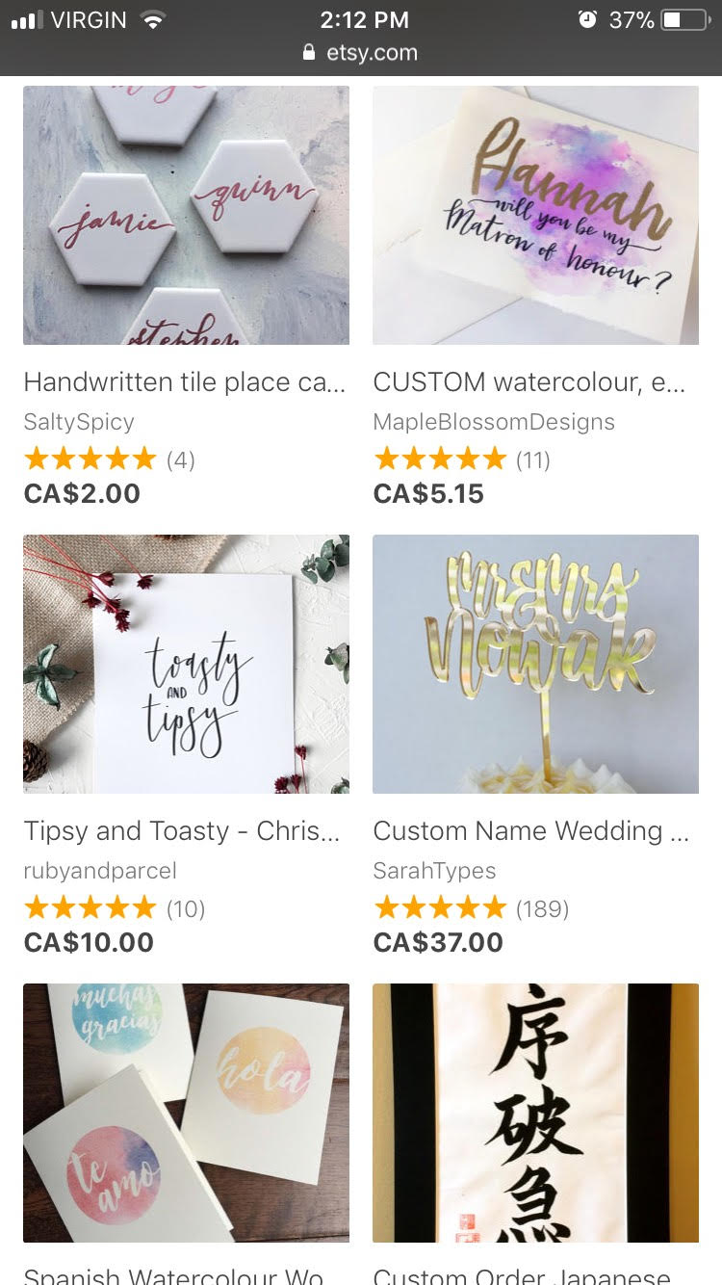
B U I L D I N G K N O W L E D G E & E X P L O R I N G I D E A S
SOURCE: https://www.printed.com/blog/calligraphy-how-to-turn-your-hobby-into-business
making money through calligra -phy | hand-lettering can be transformed from a hobby into a business there are two ways this can be accomplished: service-based: creating customized invitations, signs, place cards, etc for weddings/events off-the-shelf: selling pre-made artwork such as quotes to frame for decor, typically online
SOURCE: The Young Entrepreneur’s Edge by Jennifer Kushell
relation -ship between social media & business | social media plays a huge role in growing a business ability to advertise your store/business allows you to share artwork + gain inspiration from others’ artwork can help build relationships within the (in this case, calligraphy) community an efficient way to become more well known
https://www.etsy.com/ca/market/calligraphy

Slide 4
I D E N T I F Y I N G S O U R C E S & C H O O S I N G A T O P I C

Slide 5
IDEA:
-Calligraphy is an art with various uses, including journaling, home decor, and wedding/event decor
NEW IDEA:
-The Joker once said, “if you’re good at something, never do it for free.” Should this be true all the time?
How can I use my talents in calligraphy and word art to become a young entrepreneur?
WHICH IDEAS ARE OF MOST INTEREST TO ME?
-Taking something you love and are passionate about and making a living out of it.
IDEA:
-Art made with calligraphy can be sold to make money
NEW IDEA:
-I consider myself to be talented in calligraphy. What can I do with that talent?
Considering time, resources, and my goals, I choose….
IDEA:
-Social media is a powerful tool that can be used to share art & advertise
NEW IDEA:
-How can I use social media to improve my art? Does taking inspiration from others mean losing originality?

Slide 6
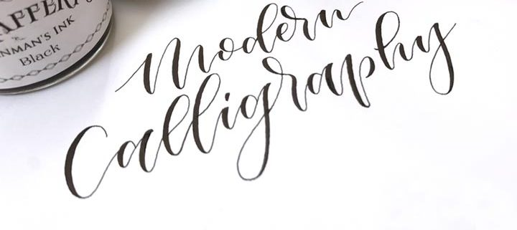
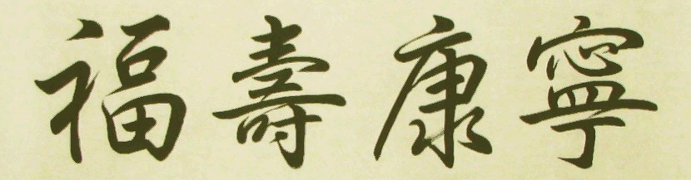
C O L L E C T I N G I N F O R M A T I O N
Some types of calligraphy:
Western - uses flat-balled pen/brush, follows precise rules/patterns
Eastern Asian - Chinese, Korean, and Japanese styles, specific brush strokes and rules
Southern Asian - Indian, Nepalese, and Tibetan styles, very consistent, uses flat brush/pen
Modern - uses a variety of mediums, created with thin upstrokes and thick downstrokes, otherwise very liberal with rules
Materials that can be used:
Crayola felt-tip markers
Ink and pointed pen
Paint and brush
Watercolours
Brush pens
tombow
sakura koi
pentel fude
brushables
zig
STA
faber-castell
water brushes
zebra
kuretake
Etsy:
Minors must have a parent or guardian to run their account
must have parent email Etsy to activate account
Price items through calculating how much was spent on materials, time, labour
how much did the materials cost?
how long did it take to make the object?
what other labour did you have to go through to make and sell it?
If you just sell digital download designs you don’t need to ship anything!
Product picture is important
good lighting
calligraphy quotes should be pictured in a frame (more professional)
Font:
Handwrite the alphabet
Scan it, send it to computer
Choose software to edit font with. Examples:
FontLab
Glyphs
Robofont
Kern font
kerning: the process of adjusting the spacing between letters or characters so that is more aesthetically pleasing
Check to see how font looks at different sizes
See how it looks printed out

Slide 7
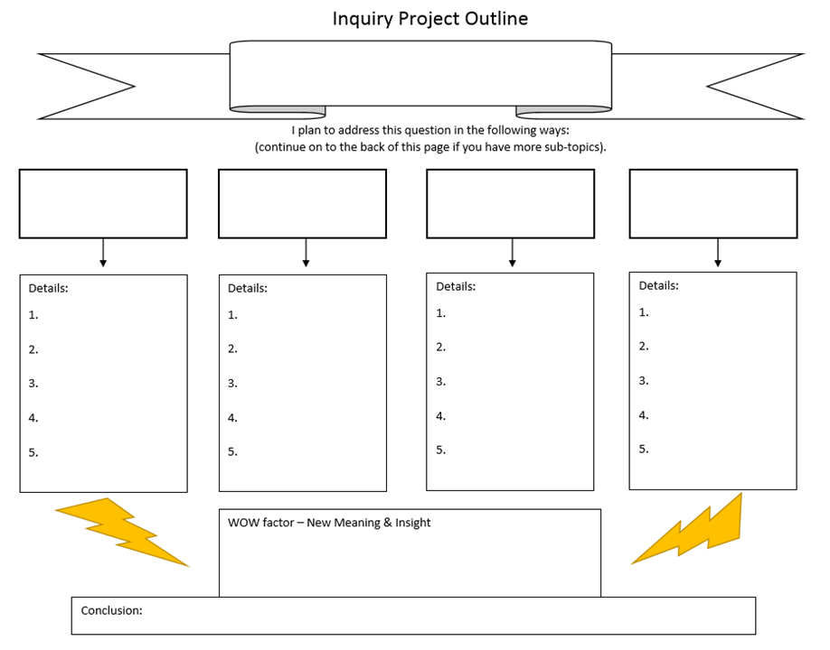
A N A
L Y Z E
S Y N
T H E
S I Z E
C R E
A T E
How can I use my talents in calligraphy and word art to become a young entrepreneur?
Make my own font
Create an online shop
Create a calligraphy Instagram
Consistently create art to post on Instagram
Handwrite my own alphabet
Research how to scan + turn it into a font
Turn it into font
Upload & sell font on Etsy
Research how to make an Etsy
Research how to price art
Create an Etsy
Upload & sell my lettering on Etsy
Create Instagram account
Follow other calligraphers
Consistently create + post calligraphy work on Instagram
Practice everyday (don’t have to post everyday though)
Look at inspiration from other calligraphers
Try new mediums
Through using my talent in calligraphy I can both improve and expand on my skills as well as enter the land of business

Slide 8
A N A
L Y Z E
S Y N
T H E
S I Z E
C R E
A T E
Topic: Calligraphy. Question: How can I use my talents in calligraphy and word art to become a young entrepreneur? Audience: This can vary, as calligraphy is used in many various places. It can be for people planning for weddings, graphic designers, logo designers, people needing diplomas to be handwritten, etc. This can also be for all teens and youth, however, to show how you can make money out of something you love. Description: I am going to create an online shop where I can sell my calligraphy products. These products will include my own handwritten font as well as handmade decorations or custom products such as custom made wedding invitations or place cards. After a little bit of research and some knowledge of other calligraphers, I want to create my own Etsy shop as well as an Instagram (apart from my personal one--a strictly calligraphy only account.) Social media is a powerful thing and I believe it will be instrumental in having a successful Etsy shop. I will post several times weekly on the Instagram of different calligraphy projects that I will make. These will also be placed on the Etsy shop. In addition, I will handwrite my own font and scan it onto my computer so that it will become available for people to buy and use on documents. Timeline: Research how to make an Etsy Shop end of unit three, week one Creation of Instagram end of unit three, week one Creation of Etsy Shop end of unit three, week two Creation of font + posted on Etsy end of unit three, week five Close to daily posting of products on Instagram + posting those products on Etsy this will begin unit three, week four and must be continuous until the overall project deadline | Resources: inspiration (examples of calligraphy projects, can easily be found on the internet) calligrapher (I know a girl named Nichola who taught a calligraphy class at the library.) Presentation: First, I will take the class on a tour of my Instagram, describing projects (such as how I made them, why I made them, the inspiration behind them.) Then I will show the class my Etsy shop and advertise like there’s no tomorrow. I also plan on taking a request for a quote/word to write from the class and then writing it in calligraphy right there in front of them so they can witness how I do calligraphy. Tech Required: my phone projector Context: I chose this project because I personally enjoy seeing word art and I recognize the effect it has on me--I am much more likely to buy a clothing item if the font is prettier than the next clothing item. I also recognize that it attracts myself and others more than a mundane font would, so it is a great tool for advertisement. More personally (and importantly), however, creating with calligraphy has had a huge impact on various different aspects of my life. Taking notes in class is actually fun for me and making it look good helps me remember things better. If I didn’t use calligraphy on my notes, I probably would not pay very much attention at all. It’s a simple but effective learning tool for me. I use calligraphy to motivate me to use my bullet journal, the one thing that keeps me organized. Without my bullet journal I’d be stressed all the time everyday, never really knowing what exactly I’m doing with anything--my journal helps me stay focused and on track with school, church, and all the other tasks I have on the side. I use calligraphy to build my relationship with my God by writing bible verses. This is super important to me, as I know that I slack a lot in my Christianity though it is the most important thing in my life. Calligraphy gives me a little more motivation to spend time with God and even use it in the mission field (which basically means bringing others closer to God.) I use it when I need a break to relieve stress. I calms me and energizes me at the same time and can help me either bring my energy level up or down. It has even saved my life--I use calligraphy in class, writing on the side of my papers to not fall asleep (sorry.) I also chose the whole entrepreneur aspect of this project because of one of my experiences in grade 6. My class did a project called “Young Entrepreneurs” where we made our own products and sold them to the rest of the school. I made teddy bears out of socks and made about $120. Looking back, I remember that it was really fun for me--the process of creating something for someone--and getting money out of it at the same time. Other than a couple garage sales at my house, I haven’t really gotten to explore that passion, so I thought this would be a good opportunity.

Slide 9
P R E S E N T :
O U T L I N E
define calligraphy (the art of beautiful lettering/writing)
wanted to create my own Etsy, font, Instagram
couldn’t finish the font, programs too expensive + I procrastinated way too much on it
started w/ creating the Instagram at the beginning of January
show it (discuss improvement, new things, where inspiration came from, etc)
talk about procrastination (show log in bullet journal)
how I promote myself + got followers
show DMs, people I talked to
demonstrate the process of posting by writing out a quote in front of class, scanning + editing it, posting it on Instagram
show Etsy
explain research
explain why there is only 1 listing (talk about parents)
M A T E R I A L S
projector
phone
dongle
notes
bullet journal
A P P S T O O P E N
Instagram - show @e210.lettering
Etsy - show E210Lettering

Slide 10
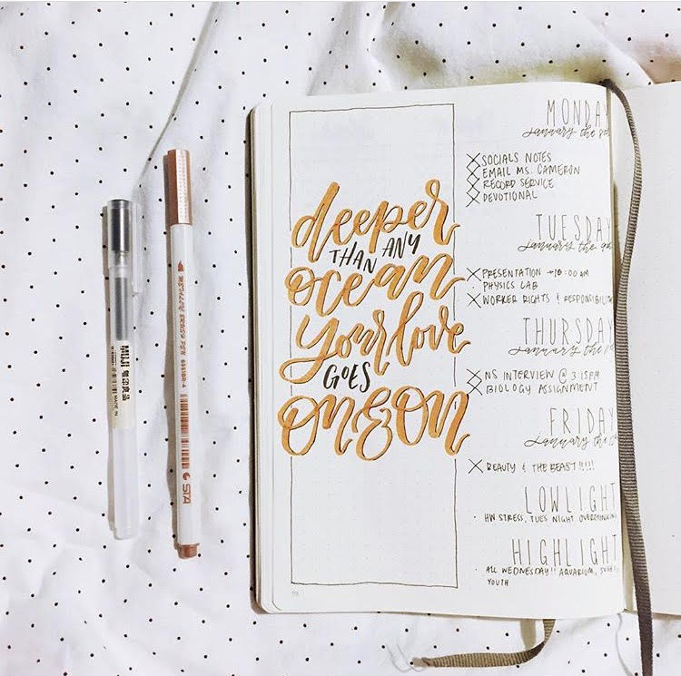
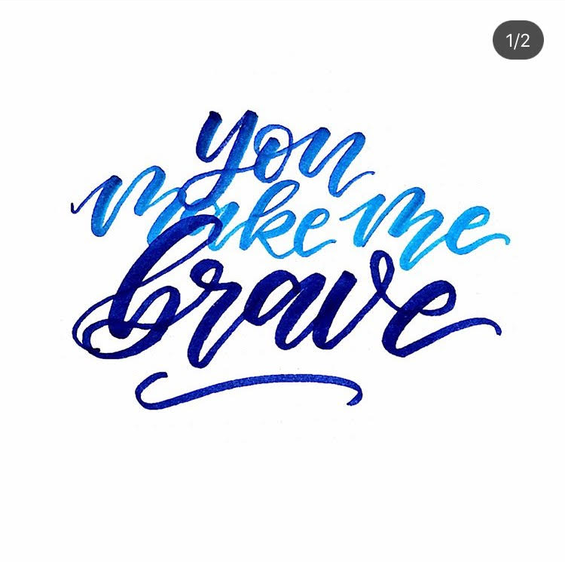
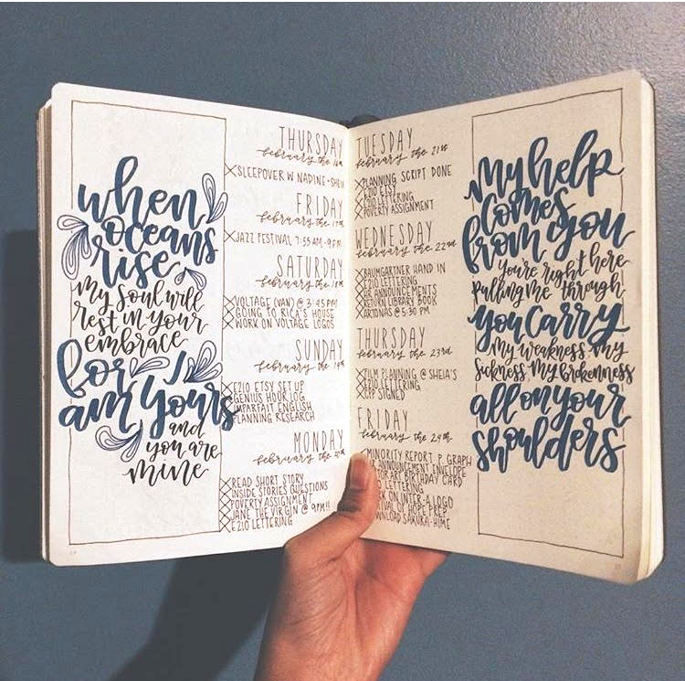
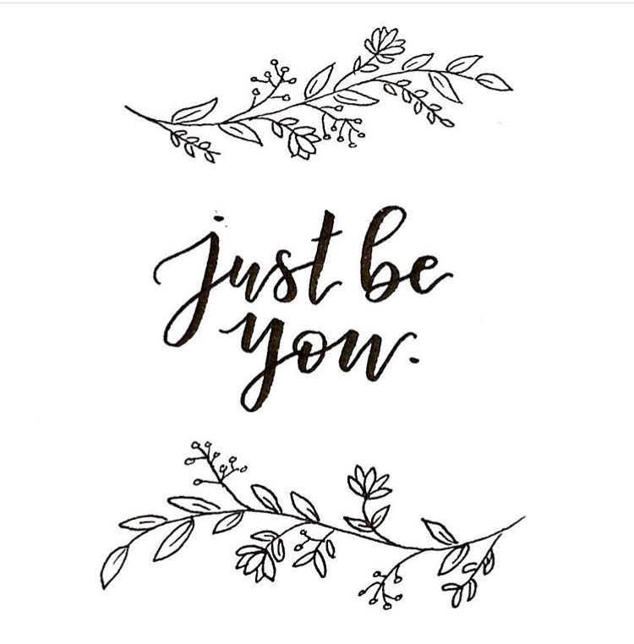
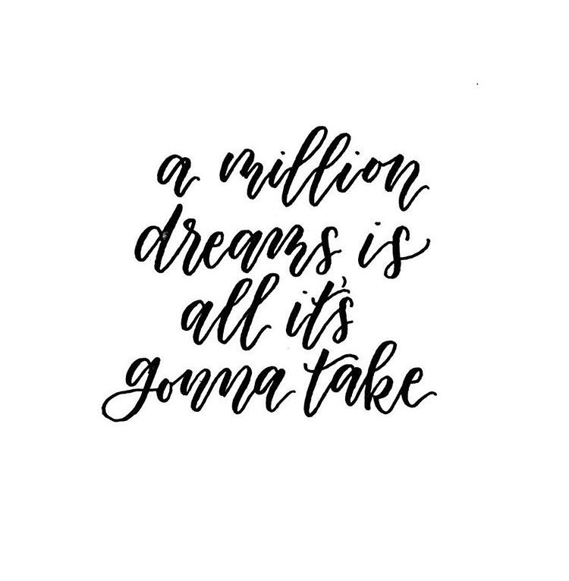
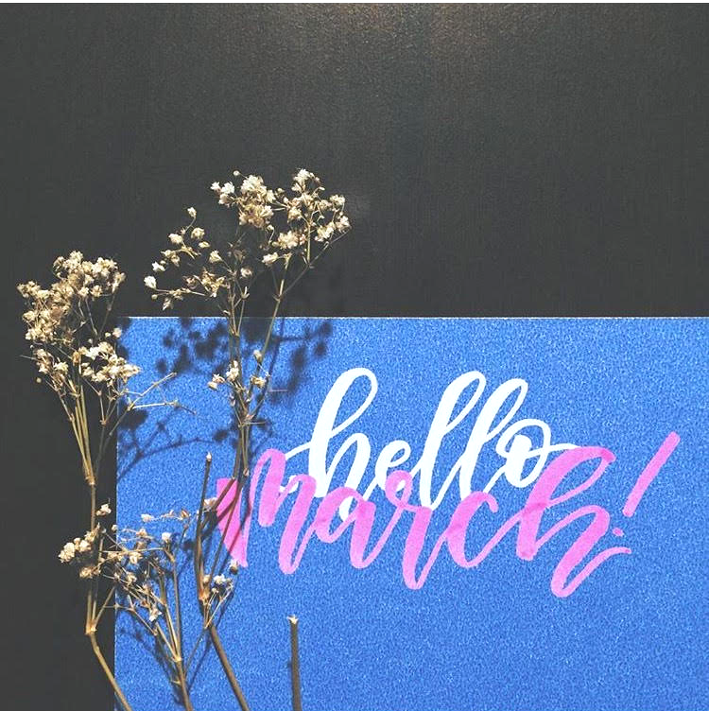
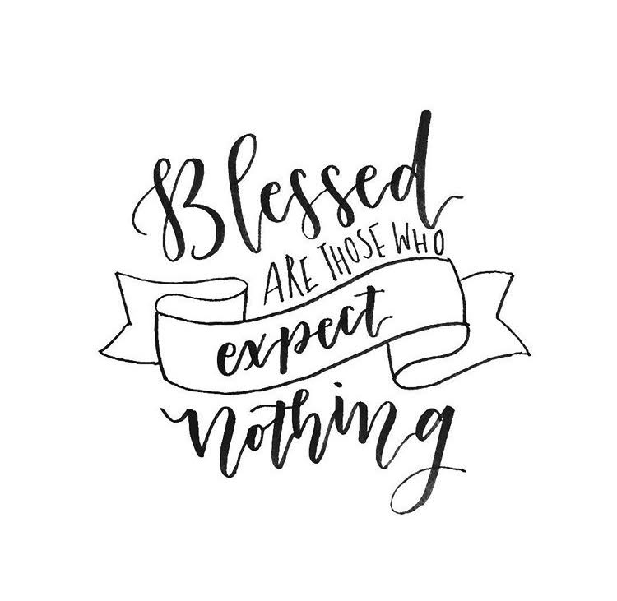
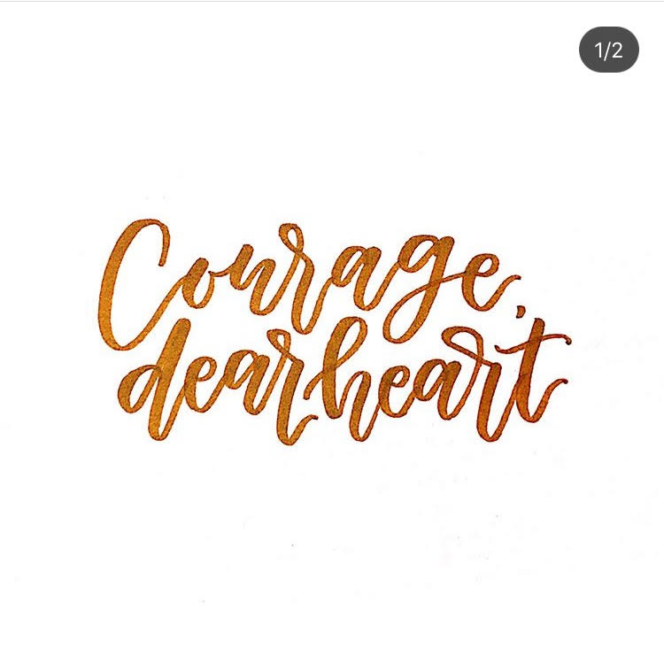
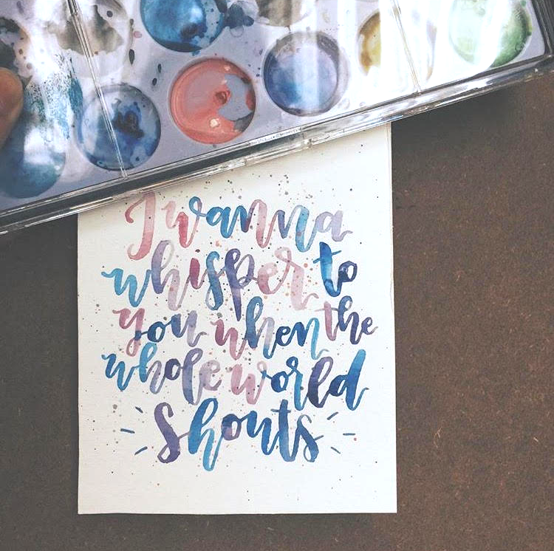
M Y W O R K INSTAGRAM: @e210.lettering (hey if you’re reading this, follow me! ;) )

Slide 11
R E F L E C T I O N
P R E P
Preparation and just starting the project in general was the hardest part, in my opinion--it was really hard to find the momentum. Choosing the project itself was so difficult--I have a lot of passions and it was really hard to just focus on one thing. Until now, though I am glad I did what I did, I still wish I could have done so much more. I also realize, however, that no matter what project I did, I still would have wanted more because I’m so in love with so many things. There really just wouldn’t be a way for me to be completely satisfied with just one project.
All of my preparation for this project consisted of research, research, and more research. Usually I don’t quite enjoy research too much, but I did enjoy it this time because I was researching something I actually cared about instead of researching pond succession or whatever. The biggest success of my preparation time was probably just being able to stay on task, as small of a success as it is (a success is a success though). It was especially difficult not to get distracted with all the technology I had to use for this project (my phone and laptop, often at the same time) with all the notifications popping around. This year was the year I actually gathered the willpower to just turn off my phone while doing work, which has been miraculously working, but I couldn’t do that with this project because I needed to scan calligraphy, do research, and stalk calligraphy accounts on social media. As I said though, surprisingly I was able to have the self-control to ignore those messages to play Facebook games and whatnot.
If I had the option to go back and change any part of my prep time, I don’t think I would since all of the information I gathered was useful and sufficed. If I could go back and maybe change my topic, even though I don’t regret the project I did do, I think I would still do a little more research on other topics that I might have enjoyed more.
A C T I O N
The action and creation was the most productive part of this project, considering it was the part with all of the actual, tangible work. I will say, however, that unlike the preparation part that there was definitely quite a bit of procrastination here.
What I’m definitely proud of is my Instagram account (@e210.lettering - follow it, tell your friends to follow it, tell your family to follow it, tell Markus from the grocery store to follow it) because of how consistent it was (in the first 75% of the project hahaha). Though my plan was to only post 3+ times a week, I ended up posting every single day which was pretty cool. I’m honestly so thankful for the push this project gave me to finally start a calligraphy Instagram, because until now I still do post on it and interact with other calligraphers and it’s the coolest thing (side note: I found two other calligraphers who are 16 years old. It’s lit.) My other successes related to this topic but not necessarily this specific project was just being able to get my calligraphy out there because of what came out of this project. One thing was getting asked to do Hanna’s wedding invitations, but then I was asked to calligs on three Europe notebooks, in cards/bday presents, and even marriage vow renewals at church. I even run a calligraphy workshop at Surrey Cental Library now (every third Thursday of the month @4:15 in the Teen Lounge if you wanna come!) I think that’s really cool.
The challenging issues of this project can be summed up in two words: procrastination & money. Often the latter causing the former. I didn’t quite figure out that Etsy cost money until around a third of the way through the project, so I was quite irked.. As a result, though the posting on Instagram continued, I completely procrastinated on actually working on that Etsy part of my project. I just didn’t want to deal with having to ask my parents to set up the Etsy with a card, convincing them that it wasn’t a scam, that no-mom-I’m-not-buying-anything, yes-I’m-sure, etc. But I can’t completely blame the Etsy, because as my presentation day neared I became more and more lazy when it came to posting so I procrastinated and started missing days because I was getting tired of it. Looking back though, I honestly don’t believe that I was tired of doing calligraphy, I was tired of going through the cycle of taking a picture, scanning it, writing out a caption, etc.

Slide 12
R E F L E C T I O N
P R E S E N T A T I O N
In all honesty, my presentation was half prepped half winged. Yes, I had an outline of what I wanted to say for the most part, but that was only really a few things and I didn’t even finish the outline because I thought I could just go with the flow.
Something that I kind of realized during/after the presentation is that my nerves come up in the opposite way than they do in the movies… You know how usually, the movie character goes up to do some sort of the performance and they think they’re going to mess up and fail or whatever but then they just do it and everything ends up being so much better than they thought it would be? Well, I’m the opposite. I went into the presentation super confident, actually wanting to go through with everything, but during the presentation I was basically just like “aaaaaaAAAAaaaaaa” the whole time. This happened to me during Destination Imagination too, I was so excited until I got to the theatre--the nerves never really hit me until I was right there in the moment. After having this realization though, I’m more aware of it and I can see it coming more often so I can prepare for it. Though it’s great to have that confidence before going into a presentation I also learned that I shouldn’t be overconfident--that’s kind of what led me to half-winging the presentation and I think I would have done a bit better if I had prepared a little bit more and actually finished that outline.
That said, (alright I’m trying not to be narcissistic here but) I am kind of amazed at myself because of how far I’ve come in terms of presenting. A year or two ago this kind of thing would have terrified me, especially because it’s a presentation I did alone and mostly about something I’m passionate about. Doing this presentation was a really good reminder of what I am capable of, because I’ll admit I get stressed and insecure once in awhile (as humans often do) and gave me something to be proud of. It might be cliche but it also reminded me that nothing is ever really as bad as you think it will be and that even though it seems difficult and far off, I am capable and will get there. Specifically what I’m thinking about right now is CSL interviews… I’ve been dreading them ever since hearing about them in grade 8, but I was also dreading Genius Hour--but Genius Hour was nowhere near as hard as I thought it was going to be and I got through it, so I will be able to get through CSL interviews, and everything else I think is scary.
F E E D B A C K & C R I T I Q U E
To be completely honest, I loved Genius Hour (I don’t know why the past classes didn’t like it? They scared me for awhile before I actually did GH I thought I was going to be so stressed). I think one of the best things about Genius Hour was our class in general and our teacher, just because of the support we got. It genuinely felt like everyone cared about every single project and I found that really cool.
I think the best part about it was that everyone was super engaged and passionate about their projects. My brother, who did Genius Hour two years before me, told me “if you don’t like Genius Hour it means you didn’t choose the right project.” I really took this to heart and made sure what I chose was what I was passionate about, so as a result I was always eager to work on it thus I used my time pretty wisely. That said, I did discuss procrastination earlier for one part of my project. If I could redo the project, I would try to make sure all aspects of the project were on the same level. When making pokemon teams, you can’t just have one really strong pokemon and five weak pokemon, otherwise if the first dies you’re done for. The same goes for a project like this.
My project didn’t turn out the way I had envisioned it at the beginning. In the beginning, it was a font, a store, and an Instagram. I ended with a blooming Instagram, an Etsy shop with one single item, earning $350 for making wedding decor, running a calligraphy workshop at the library, but no font. Though I disappointed myself in not being able to make that font, I am proud of what I did accomplish and overall a good project.

Slide 13
D I S C L A I M E R
I closed my Etsy shop a few months after this project because I didn’t want to keep up with the fees, you won’t find it if you try
(okay but that said, my IG is still going strong, follow @e210.lettering <3)

