Slide 1
Research Projects vs Inquiry Projects
A simple comparison to illustrate the difference

Slide 2
What’s the difference
Research Project
Inquiry Project
Project at the end of a unit
Teacher driven to show understanding of content
Teacher gives you the question
Limited choice
Poster? Essay? Powerpoint?
Take notes, create a product
Emphasis on the product
Viewed by teacher and maybe classmates
Content knowledge leading to deeper investigation
Personal desire to know more
Driving question created by you
Student voice and choice
21st century skills
Innovative/personal approach to research
Emphasis on the process – feedback & revision
Publically shared

Slide 3
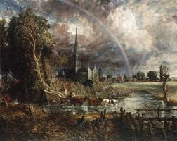

Two projects to compare
Abandoned Libraries Research Project
Abandoned Libraries Inquiry Project

Slide 4
Abandoned Libraries – a Research Project
Libraries have existed, historians estimate, for around 4000 years! During that long and distinguished history many have come and gone. The images left behind are sometimes haunting and somewhat sad.
Why have these libraries been abandoned and what might their demise tell us about changing times?

Slide 5
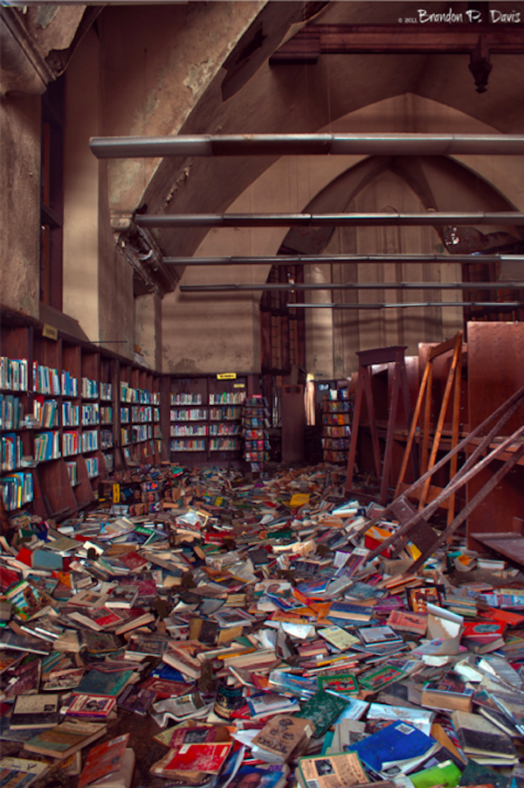
Mark Twain Branch, Detroit Public Library
First opened in 1940, the Mark Twain Branch of the Detroit Public Library was a beautiful example of arts and crafts style architecture, designed by Wirt C. Rowland.
When Detroit began experiencing major financial difficulties in the 1990s, library opening hours were limited to 2 days a week.
Funding from the state to upgrade and maintain the building was never spent, and the library closed permanently in 2011.

Slide 6
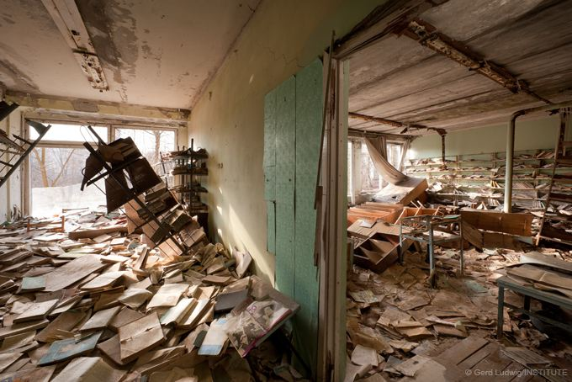
Pripyat School Library, Soviet Union
On April 26, 1986 the reactor at the Chernobyl nuclear power plant suffered a catastrophic break down resulting in the release of radiation into the air.
3 kilometers away was the city of Pripyat which has been abandoned ever since as it is unsafe to inhabit.
This is the decaying local school library.

Slide 7
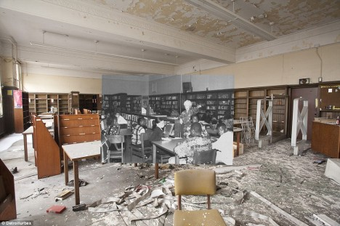
Cass Technical High School, Detroit
First opened in 1917, this high school was once the largest in Michigan, with 4200 students!
Diana Ross attended the school.
The old building needed to be replaced, and in 2005 the school was moved to a new location.
Beautiful “then and now” images of the library are especially haunting.

Slide 8
Libraries come and go…for many reasons
These three examples of abandoned libraries reflect some of the many reasons why libraries both exist and cease to exist. The changing fortunes of a city, disasters (manmade or natural), and the changing times may all affect the fortune of the library.

Slide 9
References
"Chapter 11 File: Eleven Eerie Closed & Abandoned Libraries." WebUrbanist. N.p., 2017. Web. 16 Oct. 2017.
Kelley, Claire. "The Heartbreaking Tale Of The Detroit Public Library's Mark Twain Branch » Mobylives." Melville House Books. N.p., 2017. Web. 16 Oct. 2017.
"The Abandoned City Of Pripyat." The Long Shadow of Chernobyl. N.p., 2017. Web. 16 Oct. 2017.

Slide 10
Abandoned Libraries – An Inquiry Project
Libraries have existed, historians estimate, for around 4000 years! During that long and distinguished history many have come and gone. The images left behind are sometimes haunting and, for me, somewhat sad. What has caused the demise of these places?
I believe my response to these images of abandoned libraries is somewhat “romantic.” But what does that mean?
When we describe an image or event as romantic, what are we saying? What is it about abandoned libraries that evokes this emotion in me?

Slide 11
Mark Twain Branch, Detroit Public Library
First opened in 1940, the Mark Twain Branch of the Detroit Public Library was a beautiful example of arts and crafts style architecture, designed by Wirt C. Rowland.
When Detroit began experiencing major financial difficulties in the 1990s, library opening hours were limited to 2 days a week.
Funding from the state to upgrade and maintain the building was never spent, and the library closed permanently in 2011.

Slide 12
Pripyat School Library, Soviet Union
On April 26, 1986 the reactor at the Chernobyl nuclear power plant suffered a catastrophic break down resulting in the release of radiation into the air.
3 kilometers away was the city of Pripyat which has been abandoned ever since as it is unsafe to inhabit.
This is the decaying local school library.

Slide 13
Cass Technical High School, Detroit
First opened in 1917, this high school was once the largest in Michigan, with 4200 students!
Diana Ross attended the school.
The old building needed to be replaced, and in 2005 the school was moved to a new location.
Beautiful “then and now” images of the library are especially haunting.

Slide 14
Libraries come and go…for many reasons
These three examples of abandoned libraries reflect some of the many reasons why libraries both exist and cease to exist. The changing fortunes of a city, disasters (manmade or natural), and the changing times may all affect the fortune of the library.
The images of these abandoned libraries evokes in me a sense of the “romantic.” What does that mean and why is it so?

Slide 15
What is Romanticism
Artistic movement of the 18th and 19th centuries
Focuses of passion vs reason, intuition vs logic
Free and spontaneous expression of emotion
Nature has a living spirit embodying the human feelings of love and compassion
Freedom of the individual from social customs and norms – the “romantic hero” is a rebel

Slide 16
A Romantic view
For me, these abandoned libraries evoke an emotional response. This my be because I am so passionate about libraries and to see one in ruin is heartbreaking. They are, of course, just a pile of forgotten books, yet I feel a passion and personal connection to them, illogical though that may be. They are random and unorganized yet represent so much human thought and labour. They have been rendered thus by human foibles, political or manmade, and are now victims of the same. The Romantic view is one born of passion, found beauty and personal response not hindered by convention.

Slide 17
References
"Chapter 11 File: Eleven Eerie Closed & Abandoned Libraries." WebUrbanist. N.p., 2017. Web. 16 Oct. 2017.
Kelley, Claire. "The Heartbreaking Tale Of The Detroit Public Library's Mark Twain Branch » Mobylives." Melville House Books. N.p., 2017. Web. 16 Oct. 2017.
Lipking, Lawrence. "Romanticism." World Book Student, World Book, 2017, www.worldbookonline.com/student/article?id=ar474260. Accessed 16 Oct. 2017.
"The Abandoned City Of Pripyat." The Long Shadow of Chernobyl. N.p., 2017. Web. 16 Oct. 2017.

Slide 18
What’s the difference
Research Project
Inquiry Project
Research reads like a list
Some analysis and synthesis
No personal connection
Emphasis on the product
Content leads to personal reflection and approach
Personal desire to know more
Driving question created by you
Innovative/personal approach to research

