Slide 1
Your Inquiry Project
http://librarysupportedinquiry.weebly.com

Slide 3
How is an Inquiry Project different?
Traditional Project
Inquiry Project
Project at the end of a unit
Teacher driven to show understanding of content
Teacher gives you the question
Limited choice
Poster? Essay? Powerpoint?
Take notes, create a product
Emphasis on the product
Viewed by teacher and maybe classmates
Content knowledge leading to deeper investigation
Personal desire to know more
Driving question created by you
Student voice and choice
21st century skills
Innovative approach to research
Emphasis on the process – feedback & revision
Publically shared

Slide 4
Your Inquiry Portfolio
Your Inquiry Portfolio is the digital place where you will showcase your Inquiry Project, the process and the product. It is a working document showing your progress and learning.
Throughout the project, you will use the Portfolio to:
Complete mini-assignments and reflections through regular entries
Record sources
Store notes and other documents created throughout the project
Store your completed project regardless of the format you have chosen

Slide 5
Portfolio Entries
Reflection: what is my understanding of inquiry.
Reflection: my choice for study and why.
Timeline and Goals
Background knowledge collected
Sources: annotated bibliography
My Research Question
Research Notes
Reflection: am I ready to proceed? Do I need to do more research?
Outline
Wow factor – create new meaning, ask new questions.
Draft
Project
Preparations for presentation
Reflection: in the end what did I do well, what did I learn, what would I do differently next time.

Slide 6
Getting Started – Build Knowledge and Explore Ideas
You have gained some content knowledge in your course, now you have the opportunity to explore one issue or aspect in a deeper, more thoughtful way.
This is a difficult stage as students are unfamiliar with the idea of reading to explore & expand their knowledge. Here, you determine what information already exists, and consider how to use that new knowledge to address a personally generated question.
Choose a topic or issue to pursue.
Read widely on that topic to determine what information and ideas are available and how will this inform my question creation?
Begin to collect information sources through an Annotated Bibliography.

Slide 7
Building Knowledge and Exploring Ideas SAMPLE

Slide 8
Identify Resources & Create a Question
Using what you have learned through your reading and exploring, now is the time to create your Inquiry Question. Consider
What are some of the important things you have learned in the course/about the topic?
What was surprising or new to you?
What are some things that you already knew? From where did you learn these things?
What are ideas that have come to mind since taking this course/learning about this topic?
What would you like to know more about based on the course/topic?
With your expanding Annotated Bibliography, you can now delve in to your research.

Slide 9
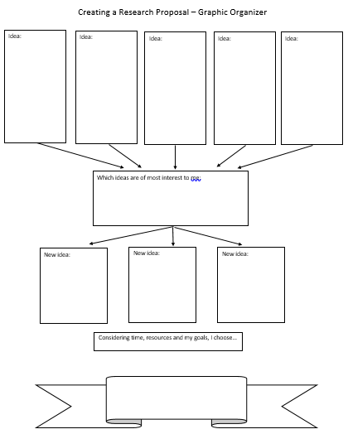

Slide 10
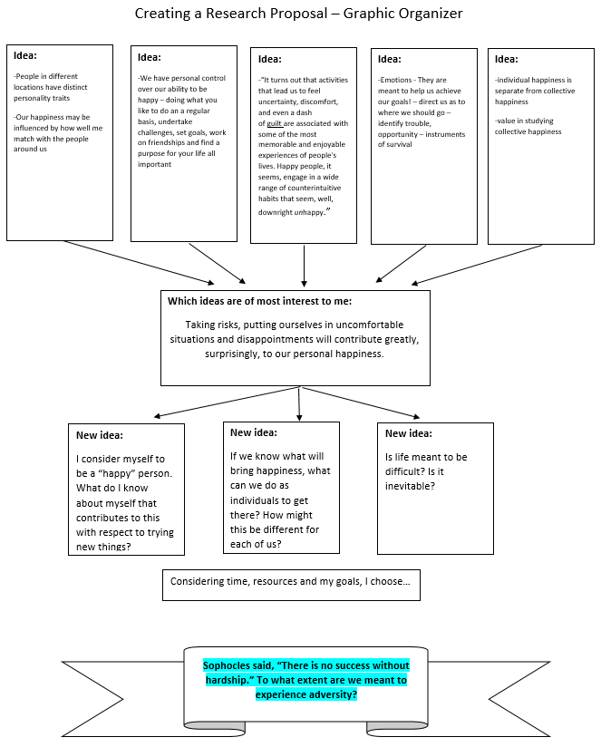

Slide 11
Collect Information: Take Notes, Summarize & Paraphrase
There are many places to go for information: books, online databases, encyclopedias and other reference works, interviews, audio and video sources to name just a few.
Use a system to take notes, remembering to record your sources carefully.
To Summarize means to put the main idea into your owns words. It is succinct and brief, an overview rather than detail.
To Paraphrase means to put the source material into your own words. It is shorter than the original; a condensing of the original source.

Slide 12
Building Knowledge and Exploring Ideas SAMPLE

Slide 13
Research Ethics and Plagiarism
Pay attention to research ethics and plagiarism.
Cite all sources correctly.
Use in-text citations if instructed to do so.
Always create original work

Slide 14
Analyze, Synthesize and Create
At this stage you will create your “product”, demonstrating your learning.
Pick a platform/tool that is appropriate to your topic and your task.
Break topic down into its component parts.
Restructure the topic in a way that is meaningful to you.
Think about what you have learned. Do you need to do more research?
What big ideas have emerged?
Can you form an opinion?
Have you answered your research question?
Have you connected the ideas you have discovered?
Have you created your own meaning?
Have you put thoughts into your own words?
Do you have a “wow” factor?
Create an outline for your project.

Slide 15
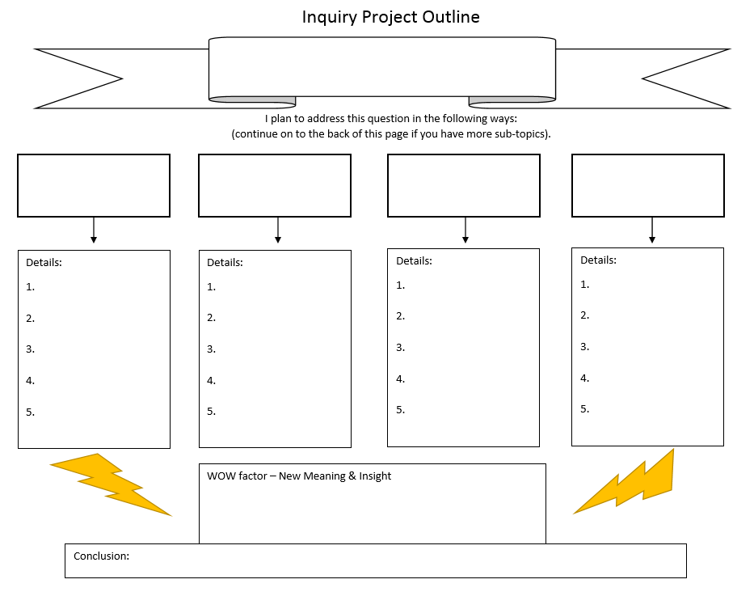

Slide 17
Present, Share, Evaluate & Reflect
Do you know your audience?
Are you ready to present your findings?
What technology or other assets will you need to present?
Is your portfolio complete?
Reflect on the process

Slide 18
Assessment
Questioning
Student applies understanding of the qualities of an effective inquiry question by frequently asking and refining inquiry questions. Sometimes requires guidance.
Thinking
Student successfully transfers critical, creative, and discipline based thinking skills when proposing an answer to the inquiry question or proposing a course of practical action. Student evaluates evidence to draw some conclusions.
Process
Student demonstrates a good understanding of themselves as a learner. Student frequently applies strategies to widen and deepen their learning through the inquiry process.

Slide 19
Assessment con’t
Information Literacy
Student successfully applies information literacy concepts and skills to accomplish learning. Student frequently gathers and analyzes multiple sources critically. Student frequently engages ethically with information and demonstrates intellectual integrity in their final product.
Communication
Student clearly communicates with the audience. Student makes good use of the terminology and vocabulary relevant to the inquiry. Shows an emerging understanding of self as a learner.
Demonstration of Knowledge
Student demonstrates a clear understanding of the content important to the inquiry. Student is beginning to extend concepts and ideas and to transfer those concepts into other areas of study, disciplines or topics.

Slide 20
Handout Package
Resource Package
Hand-in Package
Introduction to Inquiry
Project Schedule
Portfolio
Taking Notes
Summarizing
Paraphrasing
Citing Sources
Assessment Rubric
Portfolio (template)
Ongoing Works Cited Tracker
Two-column Notes sheet(s)
Creating a Research Proposal Graphic Organizer
Inquiry Project Outline Graphic Organizer
Works Cited
Project

Slide 21
http://librarysupportedinquiry.weebly.com

